Slide 1


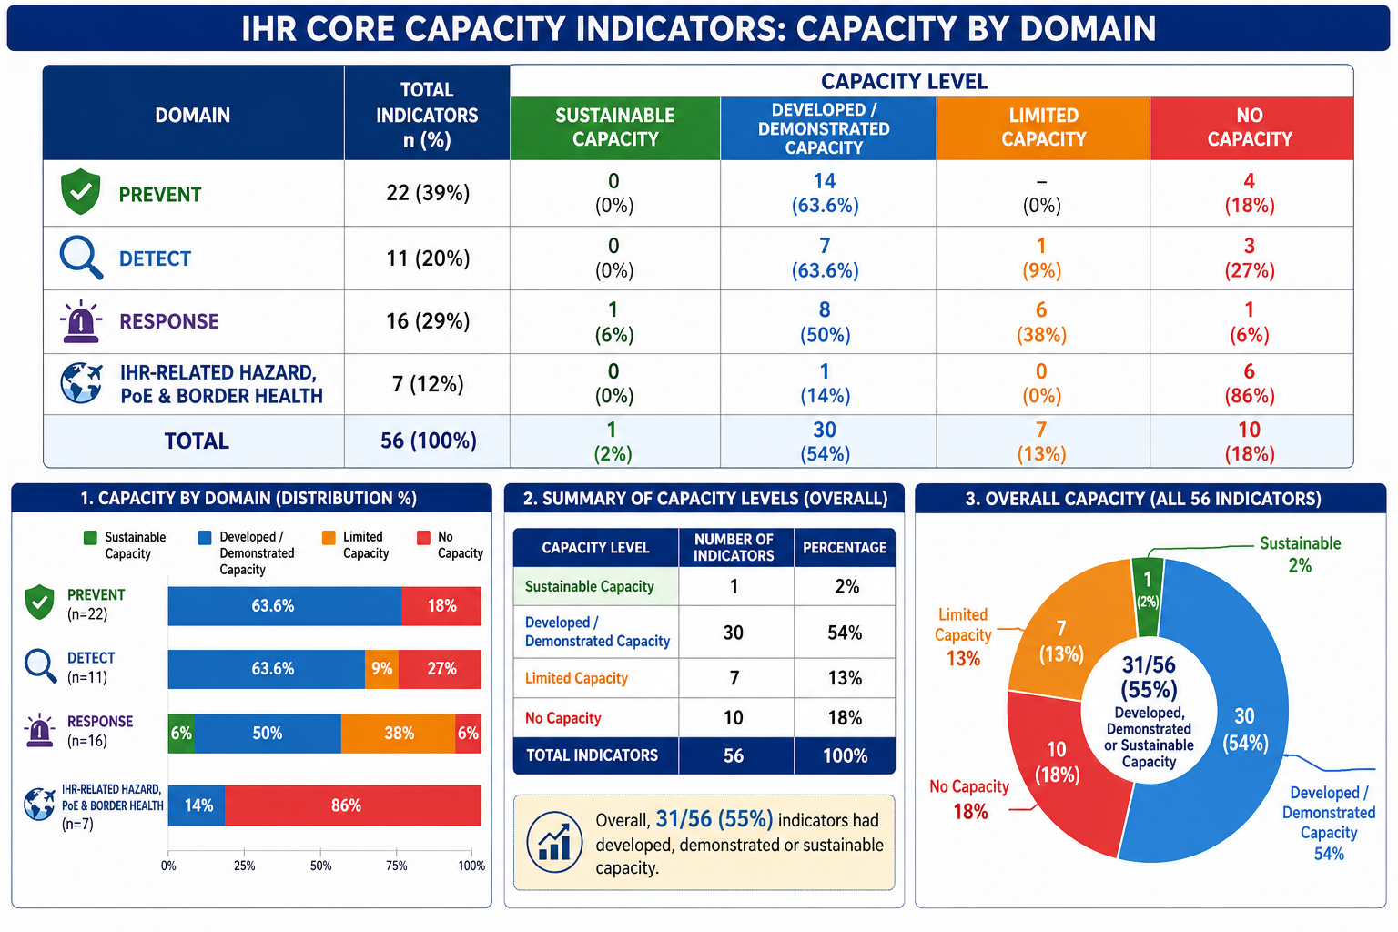
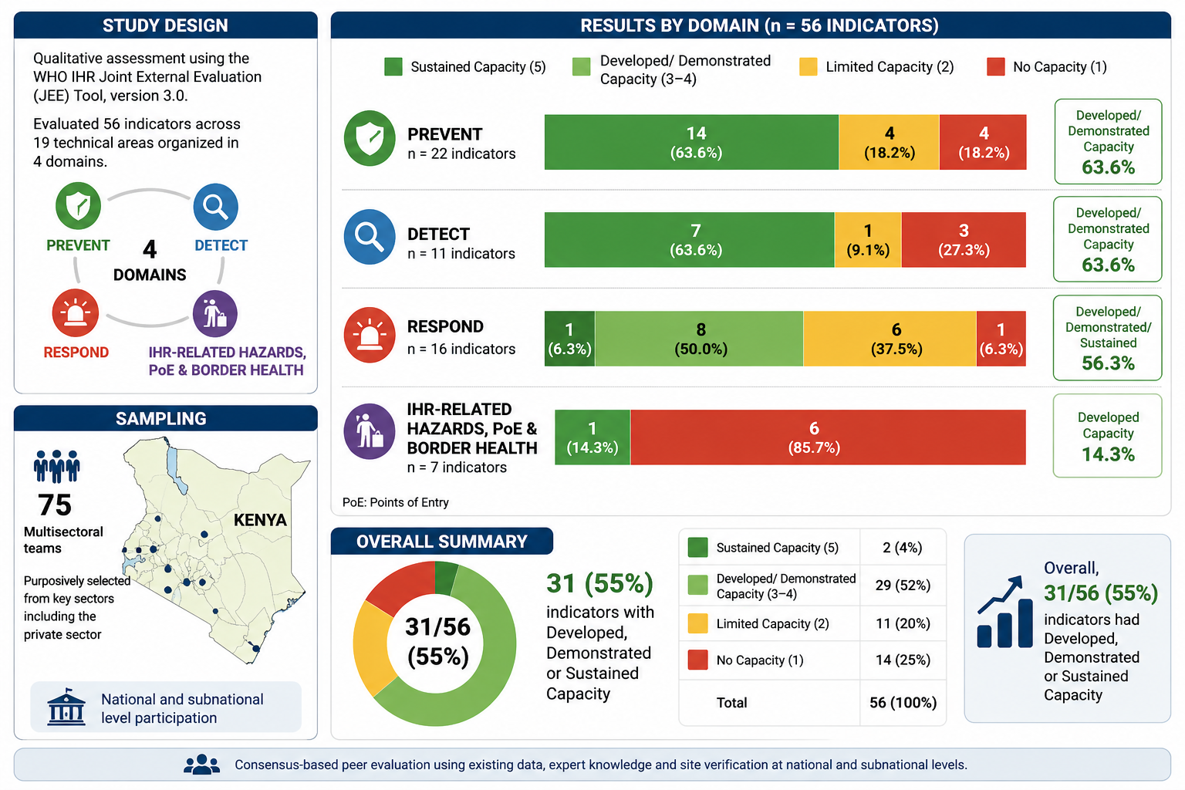




Conducting the Kenya Joint External Evaluation: Process and lessons learnt
Elizabeth Nzioka¹, Ngina Kisangau⁵, Kanana Kimonye¹, Francis Muoka¹, George Kamau¹, Khadijah Chepkorir³, Emmanuel Okunga¹, Samuel Kadivane¹, John Mwangi²,Angela Githua⁴, Kennedy Kithome⁴, Diba Dulacha⁵ Martins Livinus⁵ ,and Kamene Kimenye¹.
¹ Kenya National Public Health Institute (KNPHI), Nairobi, Kenya, ² Ministry of Environment, Climate Change and Forestry, Nairobi, Kenya, ³ Ministry of Agriculture and Livestock, Directorate of Veterinary Services, Nairobi, Kenya, ⁴ Ministry of Defence, Medical Services, Nairobi, Kenya and ⁵ World Health Organization (WHO), Kenya Country Office, Nairobi, Kenya
BACKGROUND
Kenya faces recurrent public health threats that require sustained capacity to prevent, detect, and respond to health emergencies. The Joint External Evaluation (JEE) is a voluntary peer-to-peer mechanism for assessing implementation of the International Health Regulations (IHR 2005) core public health capacities. We evaluate Kenya’s status and progress in developing core capacities to contain public health threats and inform national health security strengthening priorities.
OBJECTIVE: To evaluate Kenya’s status and progress in developing core capacities to contain public health threats and inform national health security strengthening priorities.
METHODOLOGY: We conducted a comprehensive qualitative assessment of Kenya’s IHR (2005) capacity using the World Health Organization (WHO) IHR Joint External Evaluation (JEE) Tool, version 3.0. We evaluated 56 indicators across 19 technical areas, organised in 4 domains of Prevent, Detect, Respond and IHR-related hazards, points of entry and border health. A total of 75 multisectoral teams in the country's key sectors including the private sector were purposively selected to perform the internal, whole-of-government self-evaluation. Each indicator was assigned one score: 1(no capacity), 2 limited capacity, 3 developed capacity, 4 (demonstrated capacity) and 5 (sustained capacity) based on capacity-specific attributes. To determine capacity scores, a consensus-based peer-to-peer method was employed, using existing data from routine reports, evaluation and expert knowledge of country’s health security capabilities. An external team of experts then facilitated an in-depth review of the self-evaluation data and conducted structured site verification visits at national and subnational levels.
STUDY AREA: Kenya
STUDY DESIGN AND SAMPLING
RESULTS :A descriptive analysis of 56 indicators across four domains of the Joint External Evaluation was conducted to assess Kenya’s implementation of the International Health Regulations (2005) core capacities.
Overall, 31/56 indicators (55%) demonstrated developed, demonstrated, or sustained capacity, indicating moderate progress in national health security preparedness. The Prevent and Detect domains showed relatively strong performance, with 63.6% of indicators achieving developed or demonstrated capacity in each domain.
The Respond domain showed mixed performance, with 50% of indicators demonstrating developed or demonstrated capacity, while 44% had limited or no capacity, suggesting gaps in emergency response readiness. The IHR-related hazards, Points of Entry, and border health domain had the lowest performance, with 86% of indicators showing limited or no capacity. These findings highlight the need for targeted investments, multisectoral coordination, and sustained implementation efforts to strengthen national public health emergency preparedness. We computed the readiness score for health security: an overall average score for the 19 technical areas.
DISCUSSION
The findings indicate that Kenya has made notable progress in strengthening national health security capacities
Health security readiness score of 55% indicates moderate readiness of core capacities: partially established but not yet fully functional or sustainable across all areas
The Prevent and Detect domains emerged as the most proficient areas, each recording 63.6% of indicators at developed or demonstrated levels. This reflects the establishment of solid surveillance networks, laboratory infrastructure, and preventive systems.
The Respond domain exhibited notable vulnerabilities. Only 50% of indicators reached developed or demonstrated capacity, while 44% remained limited or absent, highlighting significant deficiencies in acute operational response capabilities.
Systemic progress remains markedly uneven. There are profound disparities between the stronger detection and prevention frameworks and the comparatively underdeveloped response and border health mechanisms.
These gaps may affect the country’s ability to rapidly respond to and contain public health threats.
Domain | Total Indicators | Sustainable | Developed/Demonstrated | Limited Capacity | No Capacity
Prevent | 22 |  | 14 (63.6%) |  | 4 (18%)
Detect | 11 |  | 7 (63.6%) | 1 (9%) | 3 (27%)
Response | 16 | 1 (6%) | 8 (50%) | 6 (38%) | 1 (6%)
IHR-related Hazard, PoE & Border Health | 7 |  | 1 (14%) |  | 6 (86%)
Total | 56 | 1 (2%) | 30 (54%)
CONCLUSIONS
The findings from this evaluation suggest that Kenya has developed capacity in most of the technical areas. However, some areas require improvement, especially those with no or limited capacity. Advocacy to all key stakeholders for awareness creation, prioritization, funding and implementation of IHR 2005 is needed to ensure that all capacities are strengthened and sustained.
Contact: lizmulee@gmail.com

Slide 2
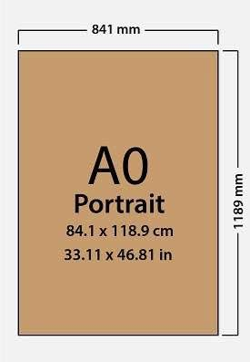
Poster Size Guideline

